Slide 1
Energy Conservation Induced Bias in Centrality Classification
Robert Dolan
For the WSU Heavy-Ion Journal Club
7/24/2026

Slide 2
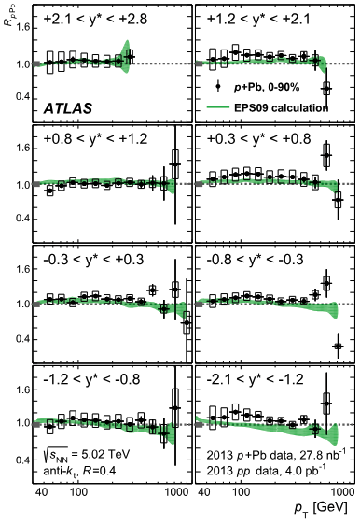
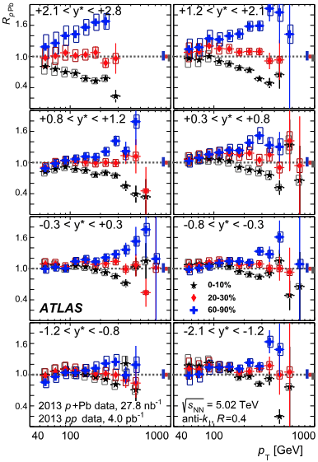
First Signs of Centrality Bias
No suppression when not centrality selected
Suppression in central events
Roughly equal enhancement in peripheral
Bias in centrality classification!
Similar results at PHENIX in d+Au from ~8 GeV
PEHNIX Coll., PRL 98 172302 (2007)
ATLAS Coll., Phys. Lett. B 748 (2015) 392-413
Notes:
Actually explain how this split happens or direct to questions.

Slide 3
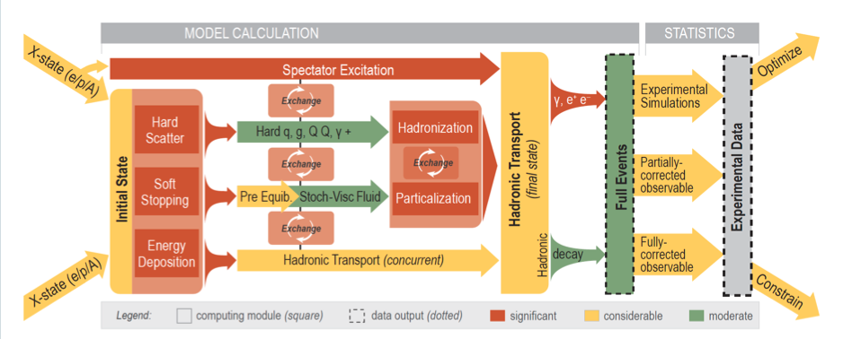
X-SCAPE Framework
Notes:
X-SCAPE is a modular, task-based framework which enables a variety of simulation workflows, including pp, pA, AA, ep, and with ongoing work xA and eA collisions (talk on this earlier today)
Try and reference Eric’s talk as well as Ritoban’s (non-JETSCAPE but uses the framework) and Yasuki’s here

Slide 4
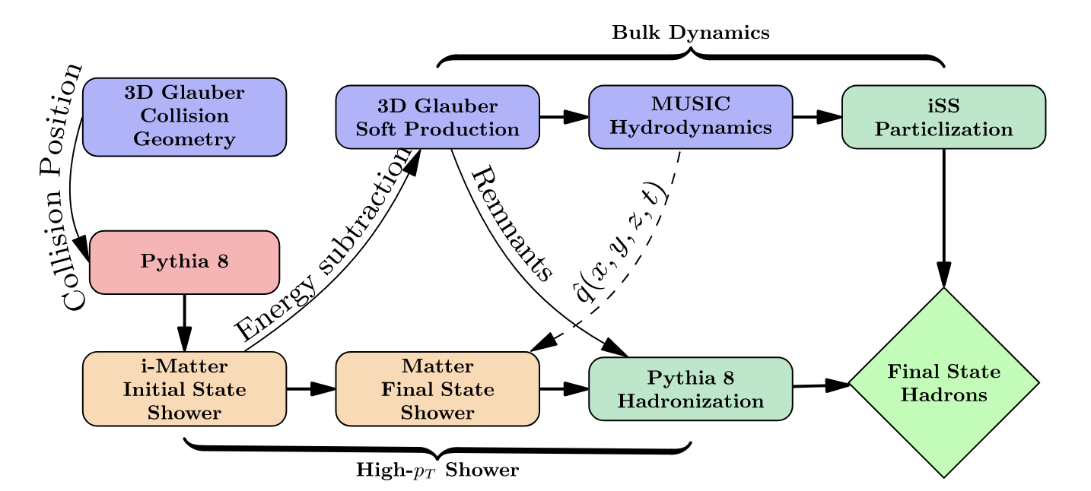
Workflow in X-SCAPE
I.Soudi et al., PRC 112, 014905 (2025)

Slide 5
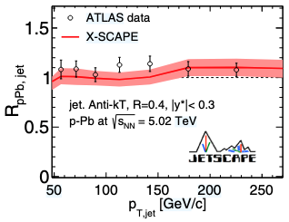
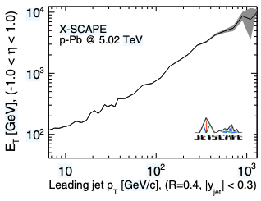
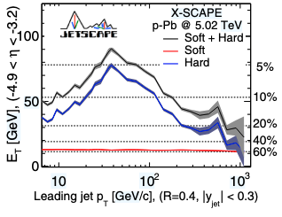
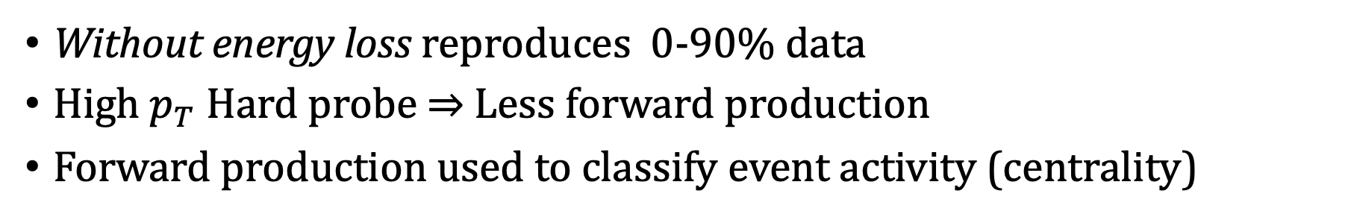
Bias from Hard Probes
Without energy loss reproduces 0-90% data
High $p_{T}$ Hard probe ⇒ Less forward production
Forward production used to classify event activity (centrality)
I.Soudi et al., PRC 112, 014905 (2025)

Slide 6
Bias from Hard Probes
Lund String Fragmentation
Soft and Fragmentation Depleted
Notes:
Make sure to mention that this peak/momentum scale will be lower at lower COM energy. RHIC will be in neighborhood a few GeV

Slide 7
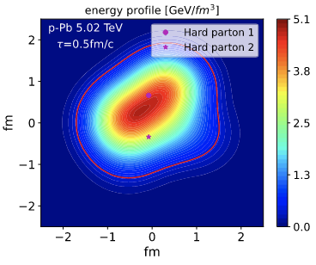
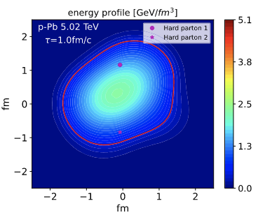
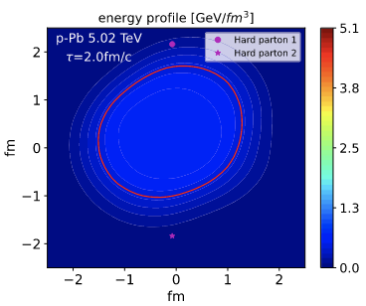
Absence of Energy Loss in Small Systems
Partons escape medium too quickly to interact
Expected to hold at RHIC with d+Au
I.Soudi et al., PRC 112, 014905 (2025)

Slide 8
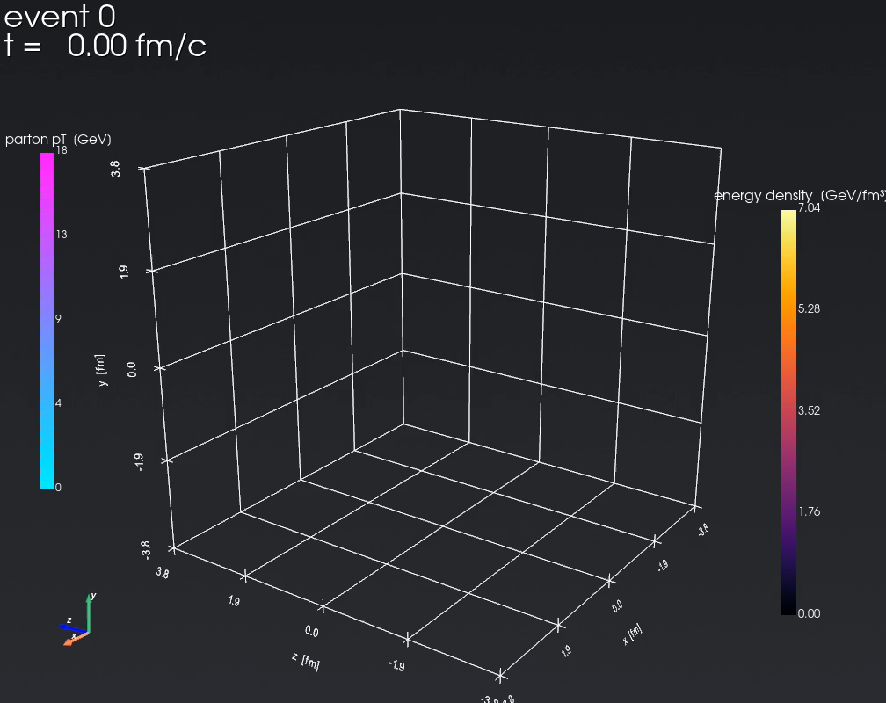

Absence of Energy loss in d+Au
Visual Credit: Joern Putschke, Wayne State University
Notes:
Second click: Pay attention to timescale. Escapes and barely interacts with medium
Done with JETSCAPE, not our setup. Our setup would have an even smaller hydro…
Caveat these simulations

Slide 9



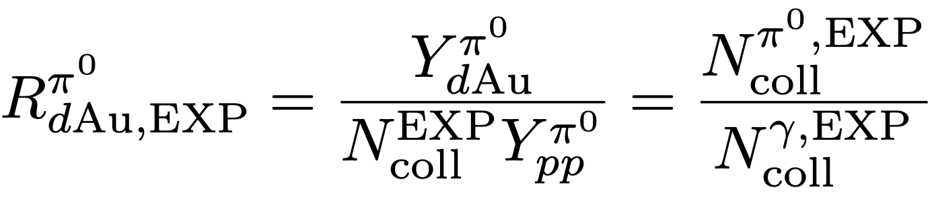
Reducing the Bias in Nuclear Modification
Centrality bias affects Ncoll value
Possible Solution: Fix Only the Ncoll
PHENIX, PRL 134, 022302 (2025)
Prompt photons: no medium effects
Yields scaled by Ncoll from pp
Apply to other yields as estimate of Ncoll
If No Energy Loss!

Slide 10
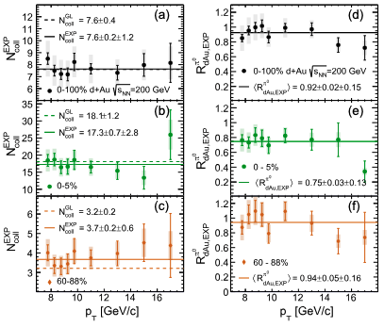
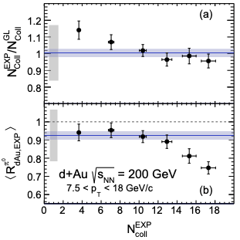
Photons: Clean Probes of Event Activity
PHENIX, PRL 134, 022302 (2025)
Notes:
They observe energy loss!

Slide 11
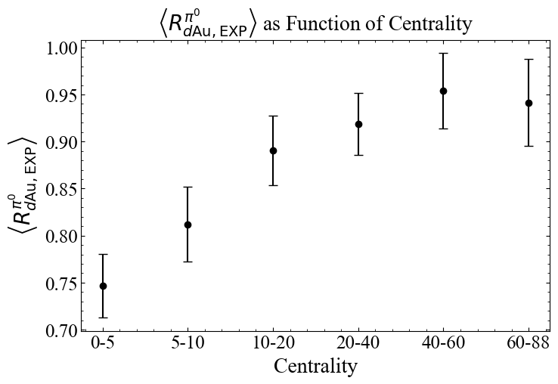
Photons: Clean Probes of Event Activity
Notes:
A quick side note, we can express this plot in terms of centrality classification which we use later

Slide 12
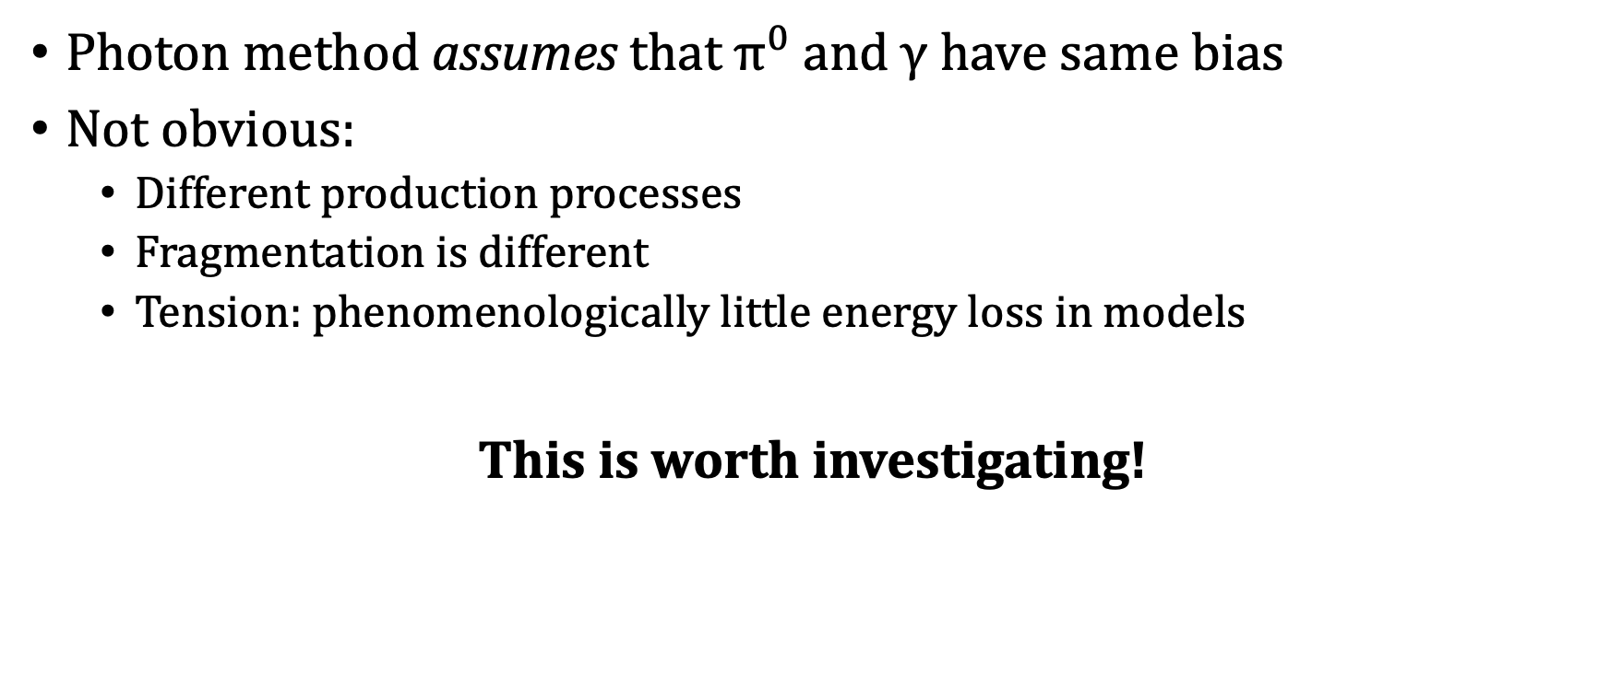
A Critical Assumption
Photon method assumes that $π^{0}$ and $γ$ have same bias
Not obvious:
Different production processes
Fragmentation is different
Tension: phenomenologically little energy loss in models
This is worth investigating!
Notes:
Fragmentation: Photon does not stretch a string which should alter how much production comes from Lund string breaking

Slide 13
Considerations and Questions
Is the suppression observed due to solely to energy conservation bias?
How large are the effects of fragmentation and shadowing?
PHENIX, PRL 134, 022302 (2025)
Notes:
They observe energy loss!

Slide 14
Considerations and Questions
Why is suppression larger at high pT in central case? Solely due to larger Ncoll?

